Slide 1
Swing in detail

Slide 2
Outline
Modern Windowing/GUI environment
Welcome to Java Swing
Handling events

Slide 3
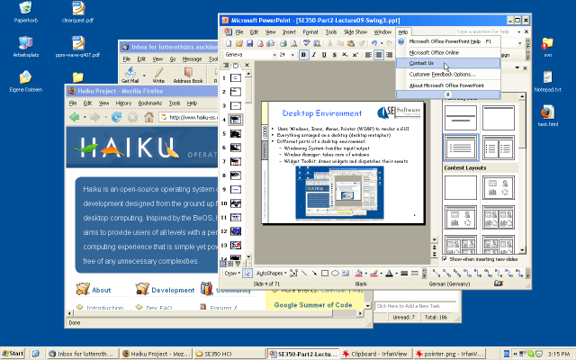
Desktop Environment
Uses Windows, Icons, Menus, Pointer (WIMP) to render a GUI
Everything arranged on a desktop (desktop metaphor)
Different parts of a desktop environment (may be merged):
  Windowing System: handles input/output
  Widget Toolkit: draws widgets and dispatches their events
  Window Manager: takes care of windows

Slide 4
Windowing System
Manages input and output devices:
graphics cards, screens, mice, keyboards
Redirects data from input devices to applications
Receives and processes drawing commands from applications
May be able to talk to remote applications: send input events and receive drawing commands over the network
Mouse
up
Mouse
up
Application 1
Mouse
Keyboard
Windowing
System
Draw
circle
Application 2

Slide 5
GUI Interaction Events
Primitive Pointer Events
Mouse Moved
Mouse Down
Mouse Up
Complex Pointer Events
Click = mouse down, mouse up
Double Click = two clicks within a certain time
Enter = mouse moves into a region
Leave = mouse moves out of a region
Hover = mouse stays in region for a period of time
Drag and Drop = mouse down, mouse moved, mouse up
Primitive Keyboard Events
Key Down
Key Up

Slide 6
Input Handling in Widgets
Input events are dispatched to the right widgets by windowing system and/or toolkit
Keyboard events are sent to widget with input focus in active window
Widgets have handlers for input events;
they can translate simple input events into more complex, specific ones (e.g. “activated”)
Developers can set event handlers for widgets, which invoke application logic
Mouse
up
Application 1
Windowing
System
Mouse
down
Button 1
Activated
Paint

Slide 7
Rendering of Widgets
Widgets have a visual representation
Widgets define “paint” event handler: draws the widget by sending commands to the windowing system
Widget gets “paint” (or “update”) events from the windowing system (possibly through toolkit)
  Often not complete redrawing, but “update region”
  Redrawing the update region is achieved with clipping
Application can send “invalidate” events to the windowing system if redrawing necessary (potentially triggers paint events)
Update Region
Activate
green
window
Button
Button

Slide 8
The GUI Event Loop
GUI application is started
Widgets are set up
Event loop is started
Wait for events from the windowing system
(event queue)
Dispatch each event to the right widget
  Input event: call appropriate event handler
  (→ call to application logic)
  Paint event: call paint method
Go back to 4.
→ Event-Driven Programming

Slide 9
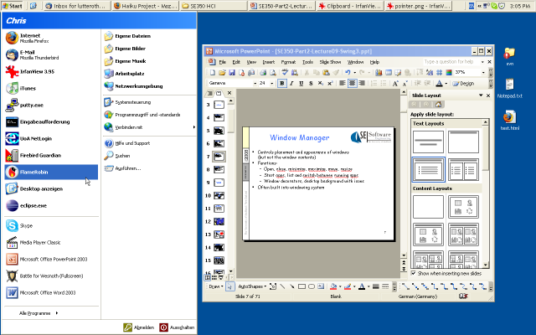
Window Manager
Controls placement and appearance of windows
(but not the window contents)
  Open, close, minimize, maximize, move, resize
  Start apps, list and switch between running apps
  Window decorators, desktop background with icons
Often built into windowing system
Implemented using a widget toolkit

Slide 10

Introduction to Java Swing

Slide 11
AWT vs. Swing
Abstract Windowing Toolkit (AWT)
Original Java GUI toolkit
Wrapper API for native GUI components
Lowest-common denominator for all Java host environments
Swing
Implemented entirely in Java on top of AWT
Richer set of GUI components
Pluggable look-and-feel support

Slide 12
Swing Design Principles
GUI is built as containment hierarchy of widgets
(i.e. the parent-child nesting relation between them)
Event objects and event listeners
  Event object: is created when event occurs (e.g. click), contains additional info (e.g. mouse coordinates)
  Event listener: object implementing an interface with an event handler method that gets an event object as argument
Separation of Model and View:
  Model: the data that is presented by a widget
  View: the actual presentation on the screen

Slide 13
Partial AWT and Swing
Class Hierarchy
java.lang.Object
CheckboxGroup
Component
MenuComponent
Button
Canvas
Checkbox
Choice
Container
Label
List
Scrollbar
TextComponent
JComponent
Scrollpane
Panel
Window
AbstractButton
JLabel
JList
JPanel
JScrollpane
Applet
Dialog
Frame
JButton
JApplet
JDialog
JFrame
java.awt.*
javax.swing.*

Slide 14
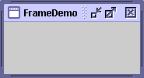
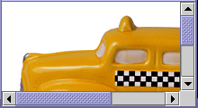
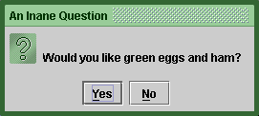
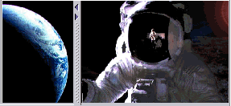

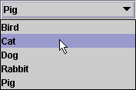

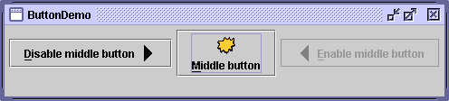
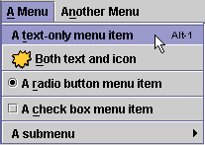
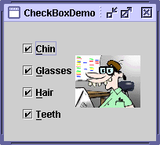
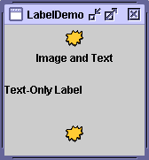
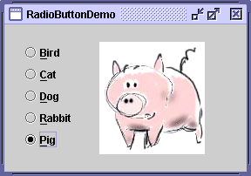
Swing Widgets (more on this next lecture)
Top-Level Containers
General-Purpose Containers
JFrame
JPanel
JScrollPane
JDialog
JSplitPane
JTabbedPane
JButton
JCombobox
JList
Menu
JCheckbox
JRadioButton
and ButtonGroup
JLabel

Slide 15
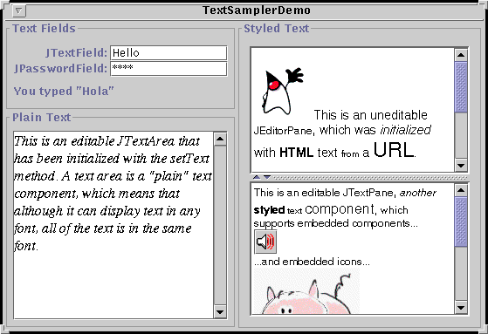
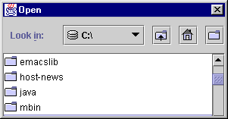
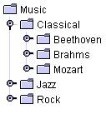
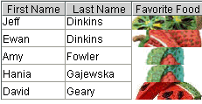
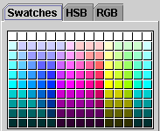
More Swing Widgets
JFileChooser
JTree
JTable
JColorChooser

Slide 16
The Initial Swing GUI
Containment Hierarchy
a 3D model enables menus to pop up above the content pane
Frame / Dialog / Applet
Root Pane
Layered Pane
File Edit
Undo
Redo
Cut
allows for interception of mouse events and painting across GUI components
Content Pane
Glass Pane

Slide 17
The Initial Swing GUI
Containment Hierarchy
aTopLevelContainer:
JFrame or JDialog or JApplet
rootPane:
JRootPane
(JPanel) glassPane:
java.awt.Component
layeredPane:
JLayeredPane
optional
(JPanel) contentPane:
java.awt.Container
menuBar:
JMenuBar

Slide 18
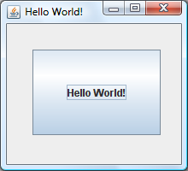
Swing Hello World
import java.awt.*;
import java.awt.event.*;
import javax.swing.*;
public class HelloWorld {
public static void main(String[] args) {
JFrame frame = new JFrame("Hello World!");
frame.setSize(220, 200);
frame.setDefaultCloseOperation(JFrame.EXIT_ON_CLOSE);
Container contentPane = frame.getContentPane();
contentPane.setLayout(null);
JButton button = new JButton("Hello World!");
button.setLocation(30, 30);
button.setSize(150, 100);
contentPane.add(button);
frame.setVisible(true);
}
}

Slide 19
Swing Hello World with Events
...
public class HelloWorld {
public static void main(String[] args) {
...
JButton button = new JButton("Hello World!");
button.addActionListener(new MyActionListener());
...
}
}
import java.awt.*;
import java.awt.event.*;
import javax.swing.*;
public class MyActionListener implements ActionListener {
public void actionPerformed(ActionEvent e) {
Toolkit.getDefaultToolkit().beep();
}
}

Slide 20

Containment Hierarchy of a Menu
…
public class MenuExample {
public static void main(String[] args) {
JFrame frame = new JFrame("My Frame");
frame.setDefaultCloseOperation(
JFrame.EXIT_ON_CLOSE);
JMenu fileMenu = new JMenu("File");
fileMenu.add(new JMenuItem("New"));
fileMenu.add(new JMenuItem("Open"));
fileMenu.add(new JMenuItem("Close"));
JMenu editMenu = new JMenu("Edit");
editMenu.add(new JMenuItem("Undo"));
editMenu.add(new JMenuItem("Redo"));
editMenu.add(new JMenuItem("Cut"));
JMenuBar menubar = new JMenuBar();
menubar.add(fileMenu);
menubar.add(editMenu);
frame.setJMenuBar(menubar);
frame.setVisible(true);
} }
File Edit
New
Open
Close
File Edit
Undo
Redo
Cut

Slide 21
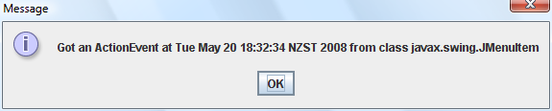
Handling Menu Events
...
public class MenuExample {
static JFrame frame;
public static void main(String[] args) {
...
JMenuItem item = new JMenuItem("Close");
item.addActionListener(new MenuActionListener());
fileMenu.add(item);
...
} }
...
public class MenuActionListener implements ActionListener {
public void actionPerformed(ActionEvent e) {
JOptionPane.showMessageDialog(MenuExample.frame,
"Got an ActionEvent at " + new Date(e.getWhen())
+ " from " + e.getSource().getClass());
} }

Slide 22
Defining Event Listeners with Anonynous Classes
...
public class MenuExample {
public static void main(String[] args) {
final JFrame frame = new JFrame("My Frame");
...
JMenuItem item = new JMenuItem("Close");
item.addActionListener(new ActionListener() {
public void actionPerformed(ActionEvent e) {
int n = JOptionPane.showOptionDialog(frame,...
}
});
...
} }
Use new Classname() {…} or new Interfacename(){…} to create a single object of an anonymous subclass of the given class/interface
Anonymous classes can access final variables of their context (i.e. final variables of the method or class they are created in)

Slide 23
Different Kinds of
Swing Events
Low-level events
MouseEvent: Component got mouse-down, mouse-move, etc.
KeyEvent: Component got key-press, key-release, etc.
ComponentEvent: Component resized, moved, etc.
ContainerEvent: Container's contents changed because a component was added or removed
FocusEvent: Component got focus or lost focus
WindowEvent: Window opened, closed, etc.
High-level semantic events
ActionEvent: Main action of control invoked (e.g. JButton click)
AdjustmentEvent: Value was adjusted (e.g. JScrollBar moved)
ItemEvent: Item was selected or deselected (e.g. in JList)
TextEvent: Text in component has changed (e.g in JTextField)

Slide 24
Events, Listeners, Adapters and Handler Methods
Event | Listener / Adapter | Handler Methods
ActionEvent | ActionListener | actionPerformed
AdjustmentEvent | AdjustmentListener | adjustmentValueChanged
MouseEvent | MouseListener MouseAdapter | mouseClicked mouseEntered mouseExited mousePressed mouseReleased
KeyEvent | KeyListener KeyAdapter | keyPressed keyReleased keyTyped
ComponentEvent | ComponentListener ComponentAdapter | componentShown componentHidden componentMoved componentResized
Adapter classes with empty methods for Listener interfaces with >1 methods

Slide 25
Event-Handling Model (1)
Some GUIs are event driven — they generate events when the user interacts with the GUI
  E.g, moving the mouse, clicking a button, typing in a text field, selecting an item from a menu, etc.
  When a user interaction occurs, an event is sent to the program. Many event types are defined in packages java.awt.event and javax.swing.event
some event classes in package java.awt.event
ActionEvent
ContainerEvent
AdjustmentEvent
FocusEvent
KeyEvent
ComponentEvent
InputEvent
MouseEvent
ItemEvent
PaintEvent
TextEvent
WindowEvent
key
CLASS
ABSTRACT CLASS

Slide 26
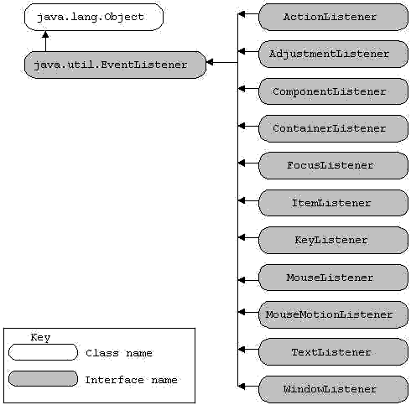
Event-Handling Model (2)
Three parts of the event-handling mechanism
  event source: the GUI component with which the user interacts
  event object: encapsulated information about the occurred event
  event listener: an object which is notified by the event source when an event occurs, and provides responds to the event
The programmer must perform two tasks to process a GUI event
  1. register an event listener
    An object of a class that implements one or more of the event-listener interfaces from packages java.awt.event and javax.swing.event
  implement an event handling method
Event-listener interface of package java.awt.event

Slide 27
JTextField and JPasswordField
They are single-line areas in which text can be entered by the user from the keyboard or text can simply be displayed
When the user types data into them and presses the Enter key, an action event occurs. If the program registers an event listener, the listener processes the event and can use the data in the text field at the time of the event in the program.
Eample code (output)

Slide 28
Buttons
A button is a component the user clicks to trigger a specific action
There are several types of buttons in Java, all are subclasses of AbstractButton
  command buttons: is created with class JButton. It generates ActionEvent
  toggle buttons: have on/off or true/false values
  check boxes: a group of buttons. It generates ItemEvent
  radio buttons: a group of buttons in which only one can be selected. It generates ItemEvent
javax.swing.JComponent
javax.swing.AbstractButton
javax.swing.JButton
javax.swing.ToggleButton
javax.swing.JCheckBox
javax.swing.JRadioButton
Example Code of JButton (output)

Slide 29
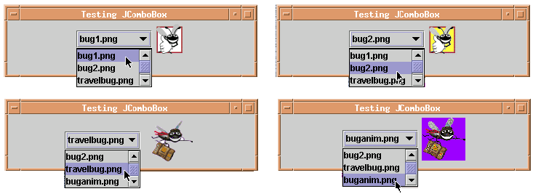
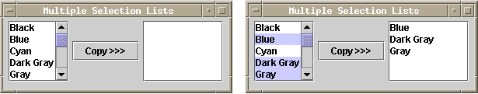
More Examples …
JComboBox: a drop-down list provides a list of items from which the user can make a selection. It generates ItemEvent
JList: a list supports both single selection and multiple-selection. It generates ListSelectionEvent

Slide 30
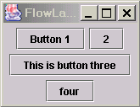

Layout Management
Let’s see an example first
All components in a container are positioned by a layout manager. Buttons in the above example are managed by the flow layout manager, which is the default layout manager for a panel.
  The default manager lines the components horizontally until there is no more room and then start a new row of components
  After resizing the container, the layout manager reflows the components automatically
  The default is to center the components in each row. You can choose aligning them to the left or to the right of the container.
    panel.setLayout(new FlowLayout(FlowLayout.LEFT));
Other managers: see http://java.sun.com/docs/books/tutorial/uiswing/layout/visual.html.

Slide 31
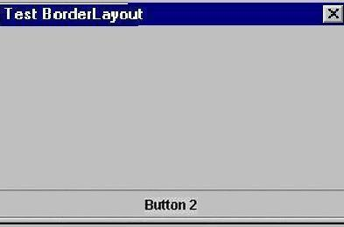
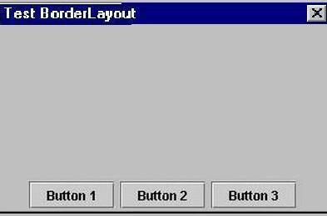
Layout Management — Using Panel
Potential problem with BorderLayout:
  The button is stretched to fill the entire southern region of the frame
  If you add another button to the southern region, it would just displace the first button
Solution – use additional panels.
  It acts as containers for interface elements and can themselves be arranged inside a larger panel
  Use flow layout by default
  To fix the problem of BorderLayout
    1. Create a panel
    2. Add components to the panel
    3. Add the panel to the larger container
JPanel p = new JPanel();
p.add(button1);
p.add(button2);
P.add(button3);
frame.add(panel, BorderLayout.SOUTH);

Slide 32
Supplemental Reading
A visual Index to the Swing Components
http://java.sun.com/docs/books/tutorial/uiswing/components/components.html
Creating a GUI with JFC/Swing
http://java.sun.com/docs/books/tutorial/uiswing/index.html
Building a User Interface
http://java.sun.com/developer/onlineTraining/new2java/divelog/part1/
http://java.sun.com/developer/onlineTraining/new2java/divelog/part2/index.jsp
http://java.sun.com/developer/onlineTraining/new2java/divelog/part3/
http://java.sun.com/developer/onlineTraining/new2java/divelog/part4/
http://java.sun.com/developer/onlineTraining/new2java/divelog/part5/

Slide 33
Summary
Desktop environments consist of:
  Windowing System: handles input/output
  Widget Toolkit:
  draws widgets and dispatches their events
  Window Manager: takes care of windows
Swing is a widget toolkit for Java
  GUI as containment hierarchy of widgets
  Event objects and event listeners
References:
http://java.sun.com/docs/books/tutorial/uiswing/
http://www.javabeginner.com/java-swing-tutorial.htm

